Slide 1

Deployment, Security, and Cloud Management
DSBA 6190-U90 | Colby T. Ford, Ph.D.

Slide 2
Deploying Azure Resources
Basics of Networking
Infrastructure as Code
ARMs and Biceps
Terraform
GitHub Actions / DevOps Build Pipelines

Slide 3
Networking

Slide 4
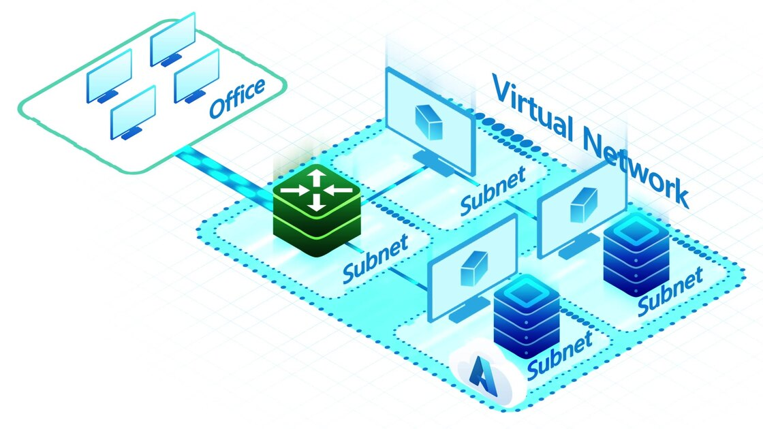
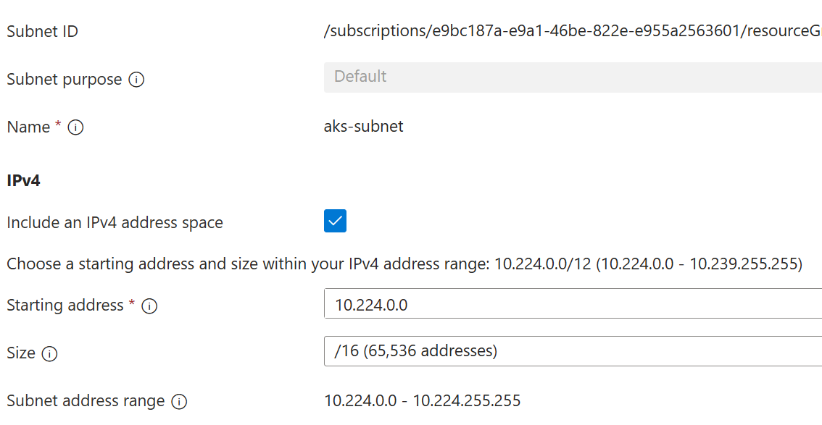
Virtual Networks and Subnets
Virtual networks, like real networks, control the communication between cloud services, the internet, and on-prem resources
Other features:
Control and filter internet vs. internal routing
DDoS protection
Network Peering
Subnets relate to a specific service, giving an address space to each (CIDR block)
Example: the subnet of our class Kubernetes service:

Slide 5
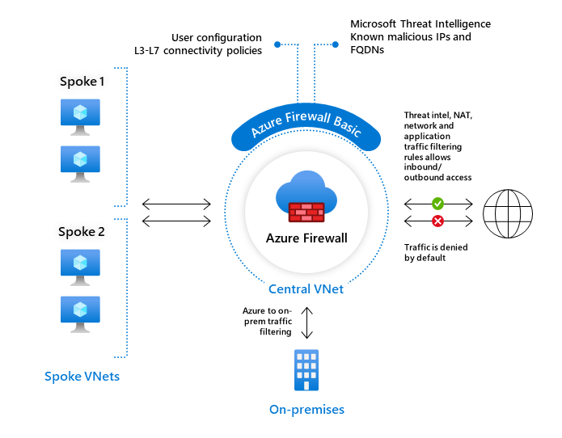
Firewalls and Private Endpoints
Firewalls:
Firewalls all you to communicate with multiple networks (including virtual networks) and control access (certain IPs, ports, etc.)
Also, it provides some enhanced threat detection, and traffic filtering, etc.
Private Endpoints:
Normally, Azure services have a public endpoint (a public URL where you can access the service from the open internet). For security reasons, you can make an endpoint for certain services as part of your vnet.

Slide 6
Infrastructure-as-Code

Slide 7
Deployment is Easy Necessary
“Infrastructure as Code” – The ability to deploy all your services in the cloud from code rather than manually.
Important for:
IT management of resources
Geo-replication / Global availability and scale
Security
Promotion of infrastructure changes from:
development → staging → production

Slide 8



Infrastructure as Code Options
ARM Templates
Bicep Language
Terraform
Pro: Azure can generate them.
Con: Difficult to read and edit.
Pro: From Microsoft. Easy to read.
Con: Lacking in examples and docs.
Pro: From HashiCorp. Multicloud.
Con: Proprietary and Pricey
Templates overview - Azure Resource Manager | Microsoft Docs
Bicep language for deploying Azure resources - Azure Resource Manager | Microsoft Docs
Docs overview | hashicorp/azurerm | Terraform Registry

Slide 9
IaC Language Learning Curve
{
"$schema": "https://schema.management.azure.com/schemas/2019-04-01/deploymentTemplate.json#",
"contentVersion": "1.0.0.0",
"parameters": {
"location": {
"type": "string",
"defaultValue": "[resourceGroup().location]"
},
"storageAccountName": {
"type": "string",
"defaultValue": "[format(myStorage{0}', uniqueString(resourceGroup().id))]"
}
},
"resources": [
{
"type": "Microsoft.Storage/storageAccounts",
"apiVersion": "2021-06-01",
"name": "[parameters('storageAccountName')]",
"location": "[parameters('location')]",
"sku": {
"name": "Standard_LRS"
},
"kind": "StorageV2",
"properties": {
"accessTier": "Hot"
}
}
]
}
param location string = resourceGroup().location
param storageAccountName string = myStorage${uniqueString(resourceGroup().id)}'
resource storageAccount 'Microsoft.Storage/storageAccounts@2021-06-01' = {
name: storageAccountName
location: location
sku: {
name: 'Standard_LRS'
}
kind: 'StorageV2'
properties: {
accessTier: 'Hot'
}
}
BICEP
resource "azurerm_storage_account" "mystorage" {
name = "myStorage${random_integer.id.result}"
resource_group_name = azurerm_resource_group.rg.name
location = azurerm_resource_group.rg.location
account_tier = "Standard"
account_replication_type = "LRS"
tags = { environment = ”dev" }
}
TF (HCL)
ARM (JSON)

Slide 10
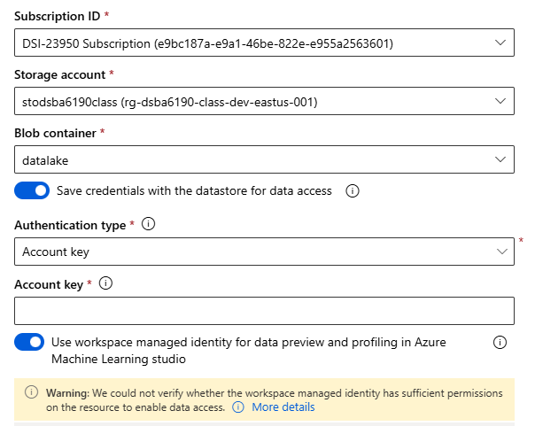
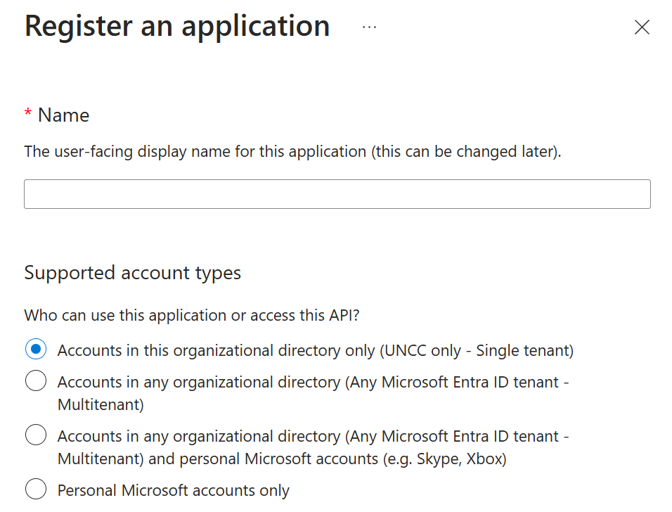
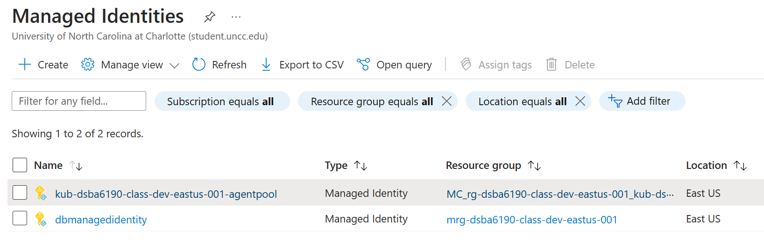
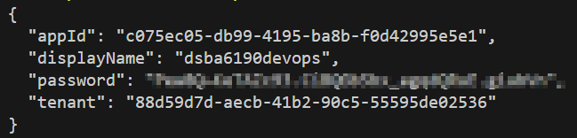
Service Principals and Managed Identities
Service Principals are like user accounts, but for services.
“Azure-representation of a non-Azure object”
Usually assigned for a specific application or purpose.
Managed Identities are a type of Service Principal that operates on behalf of other services (usually other Azure resources)
System-assigned managed identities share a lifecycle with various Azure services
Both can be given roles and permissions like users.

Slide 11
Deploying with GitHub Actions

Slide 12
Steps to Deploy with Terraform in GitHub Actions
Make GitHub Repo
Add YAML file to .github/actions folder
Add Terraform File(s) to Repo
Commit and Push Changes to Repo
Add Cloud Secrets to Repo

Slide 13
Security, Compliance, and Data Governance
Role-Based Access Controls
Azure Active Directory
Access Control Lists in Azure Storage
Compliance
HIPAA, HITRUST, SOX, ISO
Defender for Cloud
Blueprints, etc.
And more…
Data Governance: Azure Purview
Azure Chaos Studio
Subscriptions

Slide 14
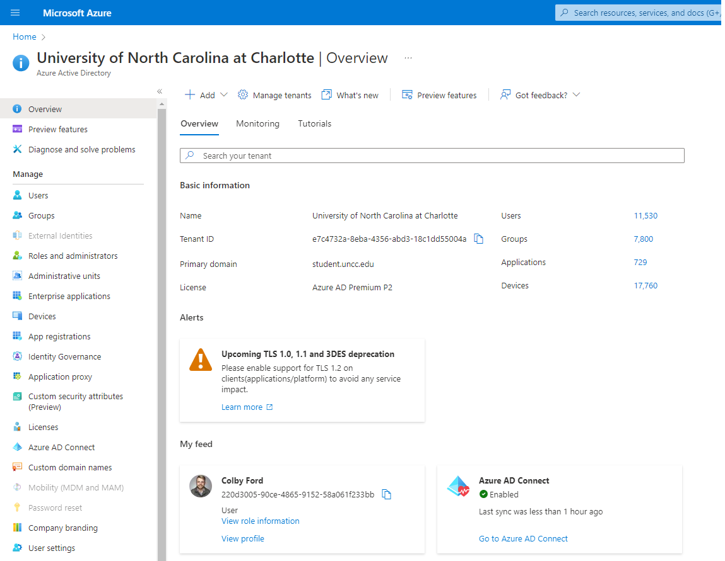

Azure Active Directory (Entra ID)
Identity management for users and applications.
Single Sign-On (SSO)
App registrations
External applications
Service Principals and Managed Identities
Role assignments
Group organization

Slide 15
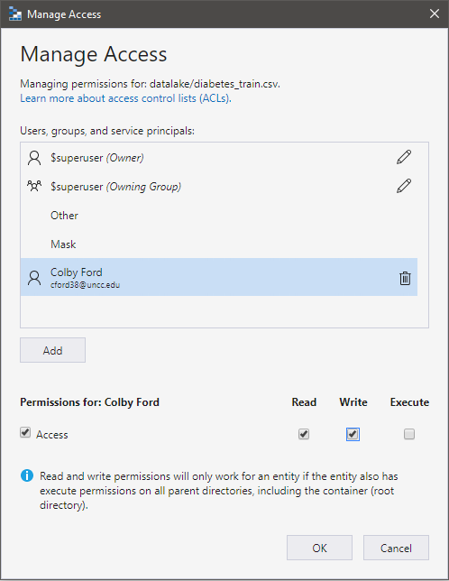

RBAC and Access Control Lists
Common Role-Based Access Controls:
Owner
Grants full access to manage all resources, including the ability to assign roles in Azure RBAC.
Contributor
Grants full access to manage all resources, but does not allow you to assign roles in Azure RBAC
Reader
View all resources but does not allow you to make any changes.
RBAC: Broad Access to Resources
ACLs: Finer Access to Data

Slide 16
Compliance noun - com·​pli·​ance | \ kəm-ˈplī-ən(t)s \ “Conformity in fulfilling official requirements”

Slide 17
Global CIS benchmark CSA STAR Attestation CSA STAR Certification CSA STAR self-assessment SOC 1 SOC 2 SOC 3 ISO 20000-1 ISO 22301 ISO 27001 ISO 27017 ISO 27018 ISO 27701 ISO 9001 WCAG | US government CJIS CMMC CNSSI 1253 DFARS DoD IL2 DoD IL4 DoD IL5 DoD IL6 DoE 10 CFR Part 810 EAR FedRAMP FIPS 140 ICD 503 IRS 1075 ITAR JSIG NDAA NIST 800-161 NIST 800-171 NIST 800-53 NIST 800-63 NIST CSF Section 508 VPATs StateRAMP | Financial services 23 NYCRR Part 500 (US) AFM and DNB (Netherlands) AMF and ACPR (France) APRA (Australia) CFTC 1.31 (US) EBA (EU) FCA and PRA (UK) FFIEC (US) FINMA (Switzerland) FINRA 4511 (US) FISC (Japan) FSA (Denmark) GLBA (US) KNF (Poland) MAS and ABS (Singapore) NBB and FSMA (Belgium) OSFI (Canada) OSPAR (Singapore) PCI 3DS PCI DSS RBI and IRDAI (India) SEC 17a-4 (US) SEC Regulation SCI (US) SOX (US) TruSight | Automotive, education, energy, media, and telecommunication CDSA DPP (UK) FACT (UK) FERPA (US) MPA GSMA NERC (US) TISAX
 |  |  | Regional - Americas Argentina PDPA Canada privacy laws Canada Protected B US CCPA | Regional - EMEA EU Cloud CoC EU EN 301 549 ENISA IAF EU GDPR EU Model Clauses Germany C5 Germany IT-Grundschutz workbook Netherlands BIR 2012 Russia personal data law Spain ENS High Spain LOPD UAE DESC UK Cyber Essentials Plus UK G-Cloud UK PASF
Healthcare and life sciences ASIP HDS (France) EPCS (US) GxP (FDA 21 CFR Part 11) HIPAA (US) HITRUST MARS-E (US) NEN 7510 (Netherlands) |  |  | Regional - Asia Pacific Australia IRAP China GB 18030 China DJCP (MLPS) China TCS India MeitY Japan CS Gold Mark Japan ISMAP Japan My Number Act Korea K-ISMS New Zealand ISPC Singapore MTCS | Regional - EMEA EU Cloud CoC EU EN 301 549 ENISA IAF EU GDPR EU Model Clauses Germany C5 Germany IT-Grundschutz workbook Netherlands BIR 2012 Russia personal data law Spain ENS High Spain LOPD UAE DESC UK Cyber Essentials Plus UK G-Cloud UK PASF
Azure Compliance Offerings

Slide 18

HIPAA, HITECH, and HITRUST
Name
Telephone Number
Address (Smaller than first 3 digits of zip code)
Dates (Smaller than years)
Fax Number
Email Address
Social Security Number
Medical Record Number
Health Plan Beneficiary Number
Account Numbers
License Number
Vehicle Identifiers
Device Identifiers and Serial Numbers
Web URLs
IP Addresses
Biometric Identifiers
Fingerprints, voice recording, etc.
Face Photos
Any other unique ID
HIPAA: Health Insurance Portability and Accountability Act of 1996
Sets requirements for using, disclosing, and handling protected health information (PHI)
HITECH: Health Information Technology for Economic and Clinical Health Act of 2009
Extends HIPAA for electronic health records and more modern, data-driven technology in healthcare
HITRUST: Health Information Trust Alliance
A private company that sets standards, based on HIPAA/HITECH, and provides certification.
https://docs.microsoft.com/en-us/azure/compliance/offerings/offering-hipaa-us

Slide 19
SOX
Retain data for the req’d amount of time
Manage security and access controls
Know when something is deleted or changed (version control)
Physical and electronic access
Offsite backups
Prevent data tampering
Audit trails, logs
Prove you’ve retained compliance for a rolling 90 days
Visibility into system and org compliance
Sarbanes-Oxley Act of 2002
US federal law from the Securities and Exchange Commission (SEC)
Mandates financial record keeping practices
Thanks to the ENRON and WorldCom scandals

Slide 20
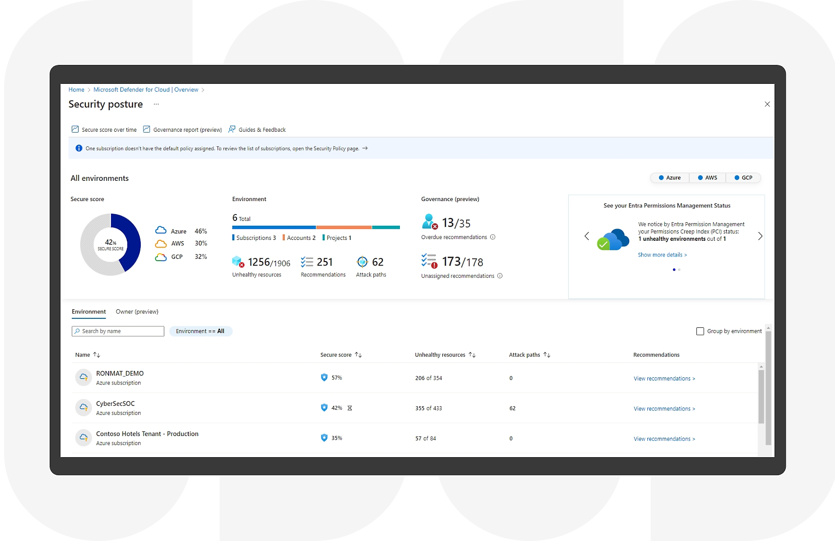

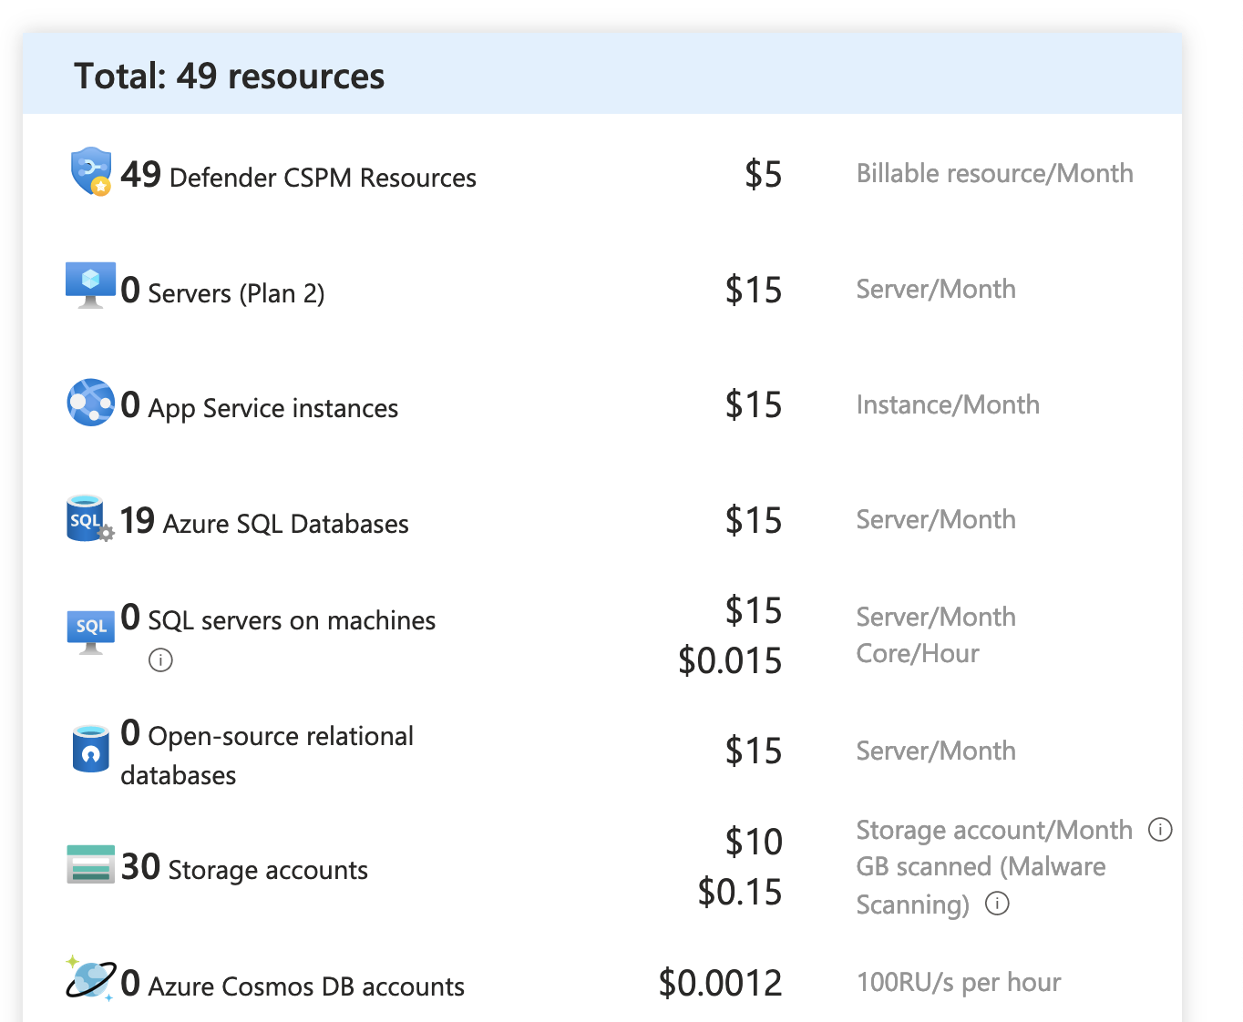
Defender for Cloud
Reviews your various services to check for vulnerabilities
Assesses your compliance to various security standards
Works across clouds
Pay by the resource

Slide 21
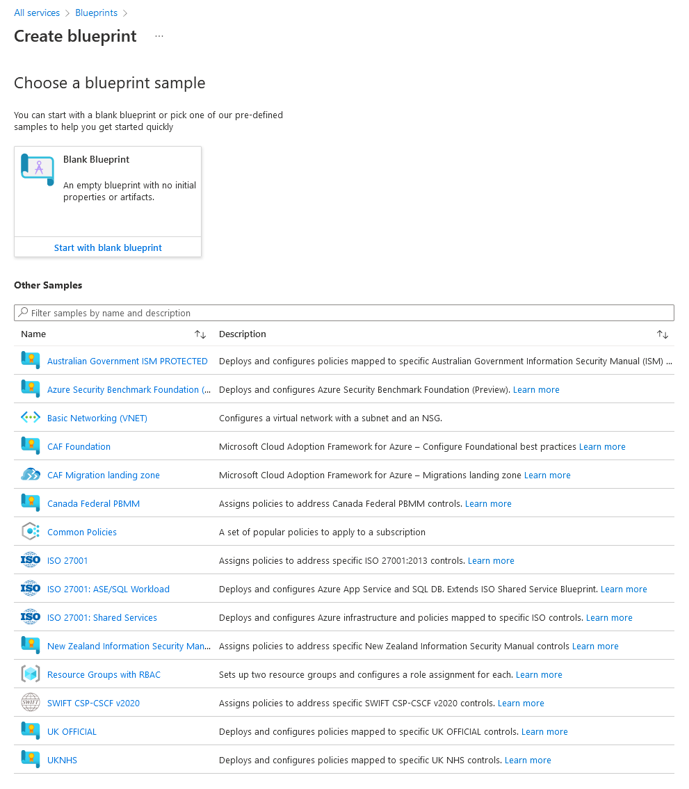

Azure Blueprints
Set of organizational standards and requirements for compliance or policy adherence.
Orchestrate the deployment of artifacts:
Role Assignments
Policy Assignments
Azure Resource Manager templates (ARM templates)
Resource Groups

Slide 22
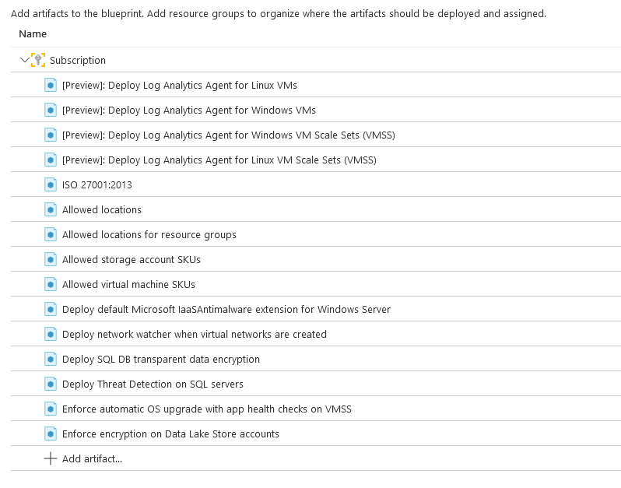

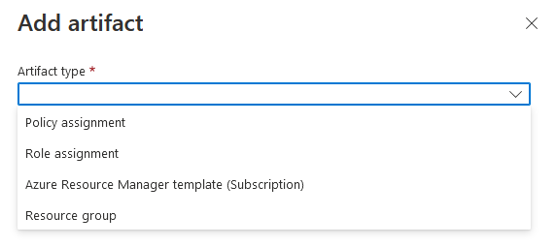
ISO 27001
International Standard for information security
14 main Controls
Information security policies, HR security, asset management, access control, cryptography, physical security, etc.

Slide 23
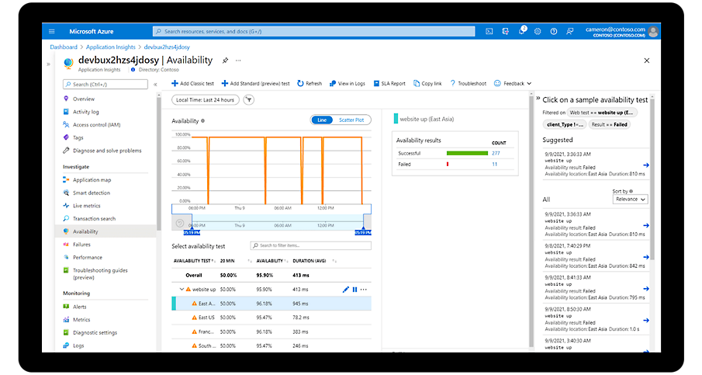

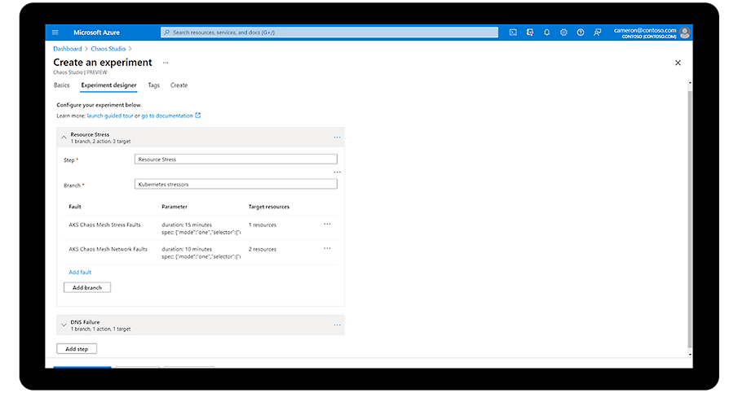
Azure Chaos Studio
Run experiments to see how your infrastructure handles certain scenarios
Disaster recovery
Fault injections
Code optimizations

Slide 24
Now that I have a bunch of stuff in the cloud, how do I see it all?

Slide 25
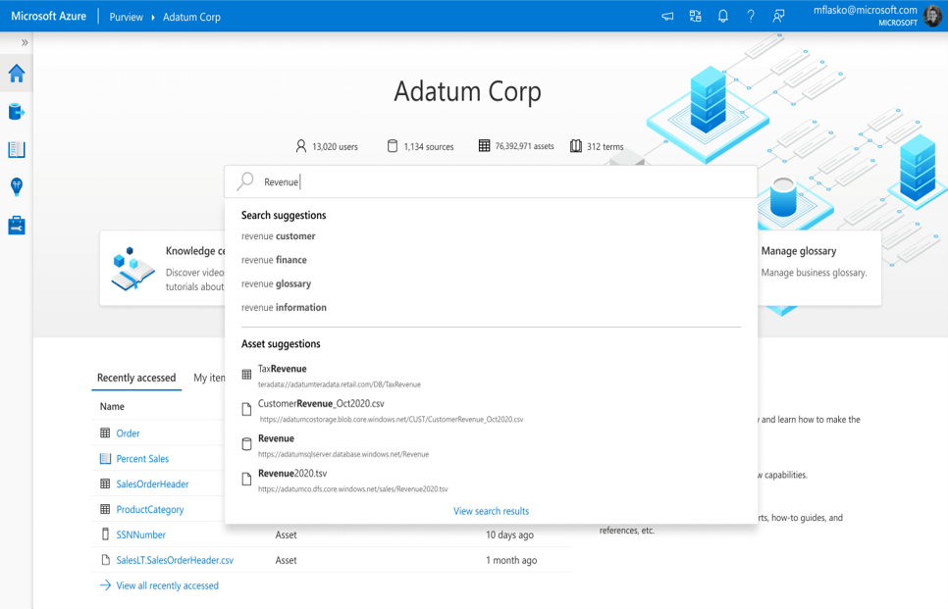
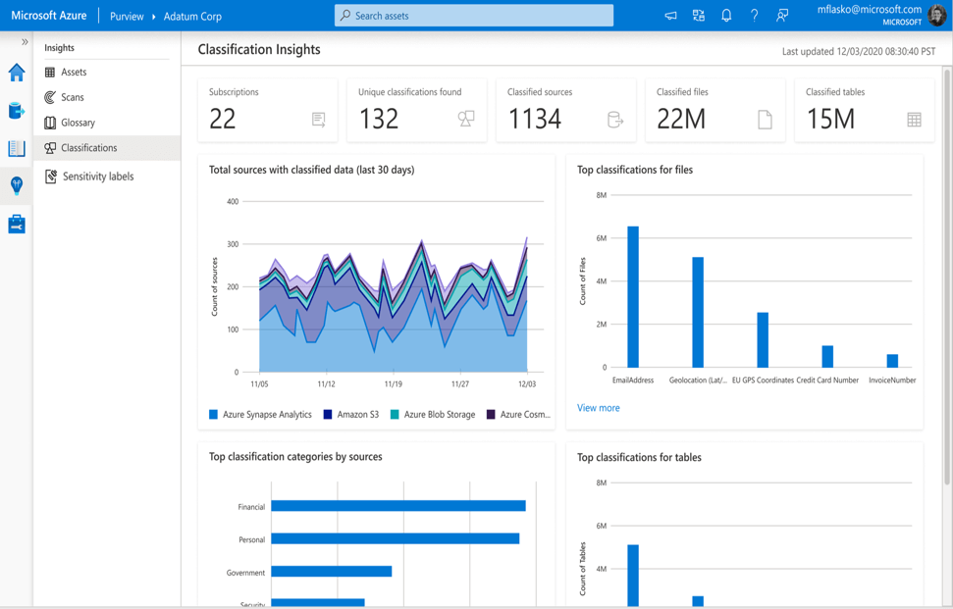
Azure Purview
Data governance platform in Azure that allows us to manage on-prem and multicloud data and services.
Create a map of your data estate – “Data Catalog”
Find, label, and track sensitive data.
See how data flows through your platforms

Slide 26
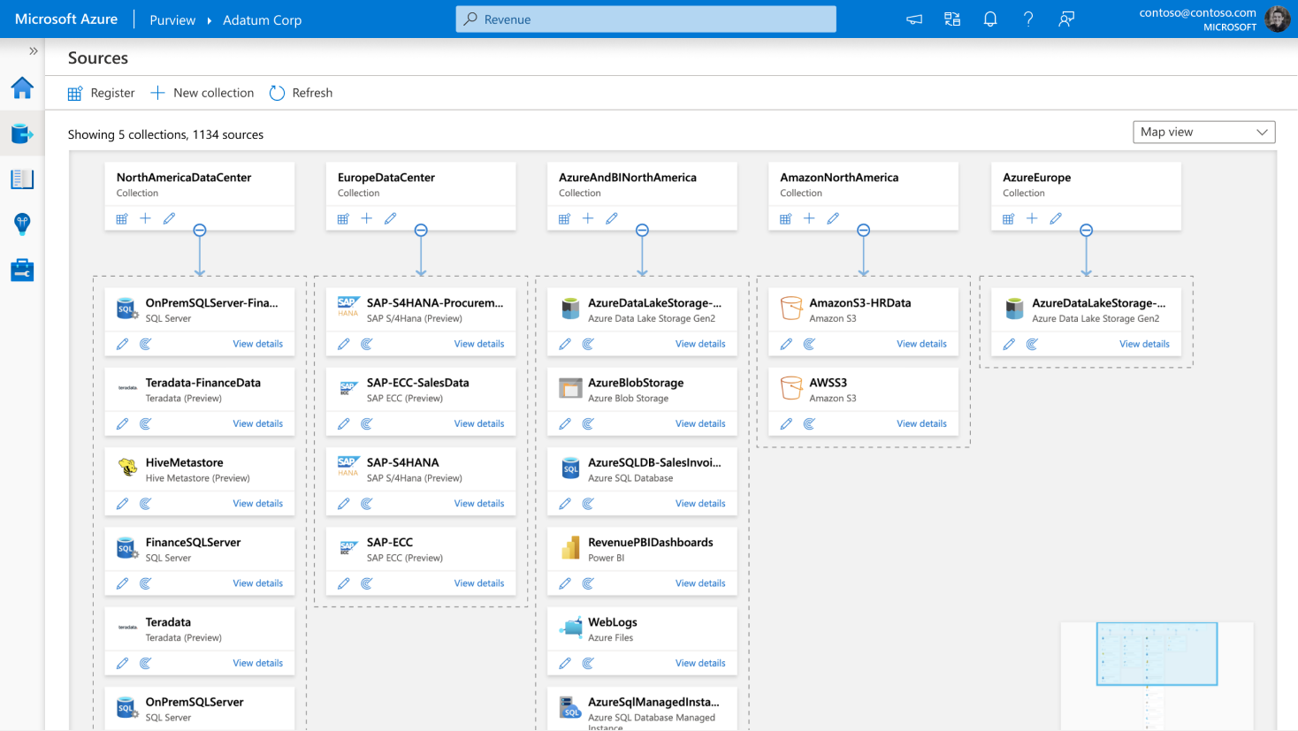

Slide 27
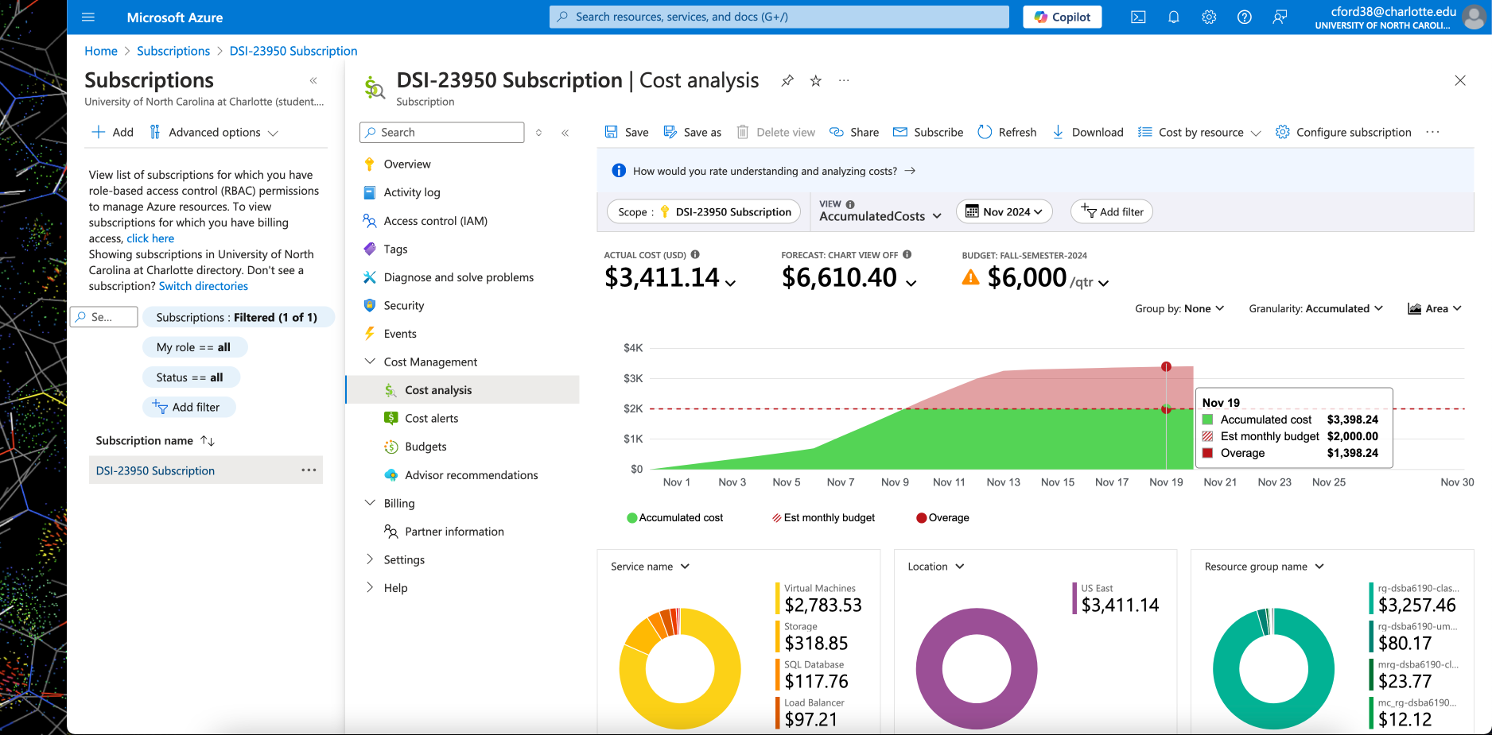

Subscriptions
Subscriptions are the place where cloud services are billed
In smaller organizations, it’s common to see a single Subscription for the whole company
In larger organizations, you may see Subscriptions set up for individual groups or applications
Also, maybe even separate Subs for dev, staging, and production.
There are different “offer types” that may affect pricing.
Pay-as-you-Go vs. Enterprise Agreement
https://azure.microsoft.com/en-us/support/legal/offer-details

